Slide 1


Pairs Trading on Banks
NYSE: BAC
NYSE: PNC
Matthew Li, Jack Rong, Abhishek Mukherjee, Daniel de Beer
Advisor: Daniel Li

Slide 2
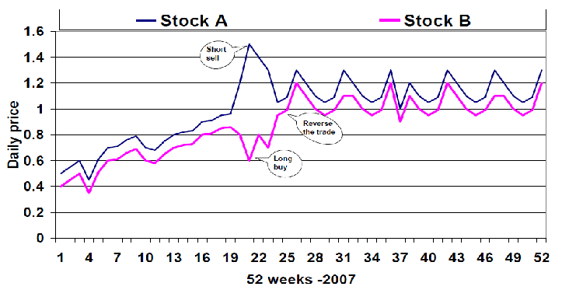
Pairs Trading
Strategy Explanation
Restrictions
Market-neutral strategy: a strategy that attempts to profit from both positive and negative trends in certain markets
Based on the historical correlation of two positively correlated securities, trades occur when the prices deviate away from the observed correlation
Long position on the underperforming security and short position on the overperforming security, profiting when the prices eventually converge
Generally requires a correlation of over 0.8
However, the higher the correlation, the less prices deviate and less opportunity for returns
More volatile securities tend to have less correlation since there are more independent drivers

Slide 3
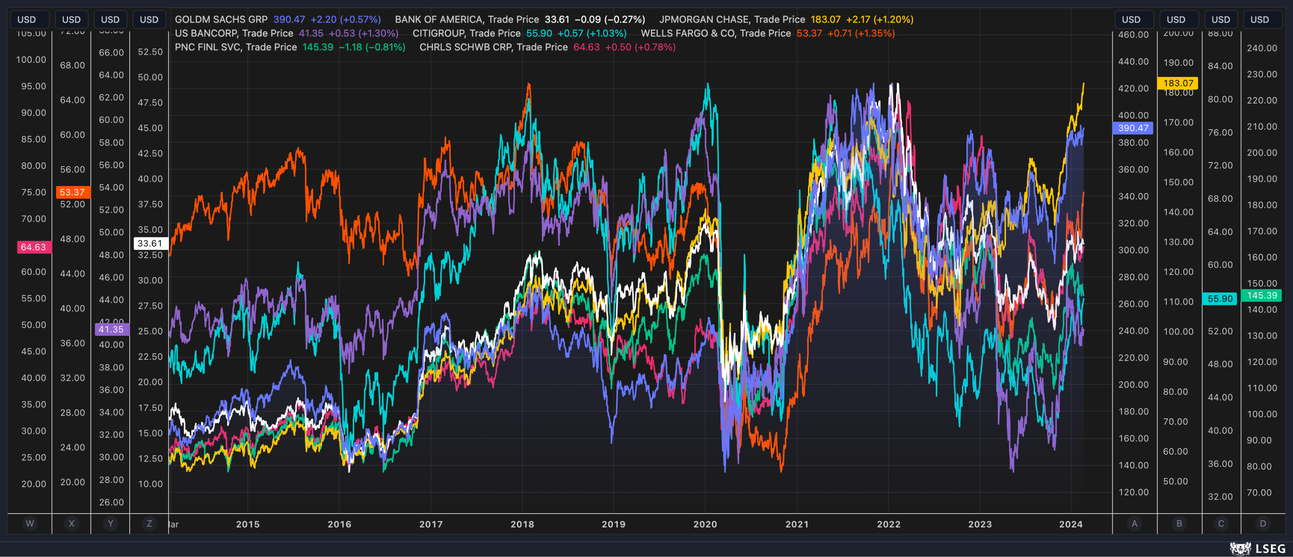
Why Banks?
Stronger correlation
Banks Tested
Banks are often exposed to similar drivers since they hold similar assets, especially those with holdings in public markets
Tested theory by including banks exposed to different sets of markets
High tendency for prices to converge after periods of volatility
Bank of America (NYSE: BAC) $2.4T AUM
JP Morgan Chase (NYSE: JPM) $3.3T AUM
US Bank (NYSE: USB) $657B AUM
Citigroup (NYSE: C) $1.6T AUM
Wells Fargo (NYSE: WFC) $1.7T AUM
PNC Financial (NYSE: PNC) $553B AUM
Charles Schwab (NYSE: SCHW) $959B AUM
Morgan Stanley (NYSE: MS) $1.4T AUM
Goldman Sachs (NYSE: GS) $538B AUM
Truist Financial (NYSE: TFC) $535B AUM
ICICI Bank (NYSE: IBN) $191B AUM

Slide 4
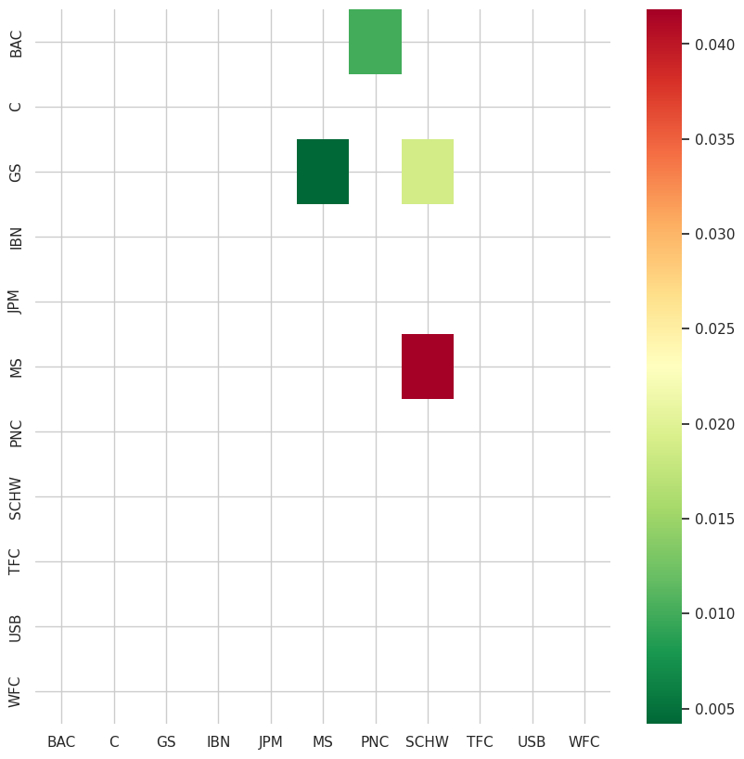
Choosing the Banks
Correlation Matrix
Used coint as cointegration test to see if prices were correlated over 2013-2020 period
Found 4 possible pairs:
PNC : BAC
MS : GS
SCHW : GS
SCHW : MS
PNC : BAC was chosen because the pair had the largest combined AUM and similar markets
Results confirmed first hypothesis that correlated banks operates in similar markets (ICICI Bank showed the worst correlation)

Slide 5
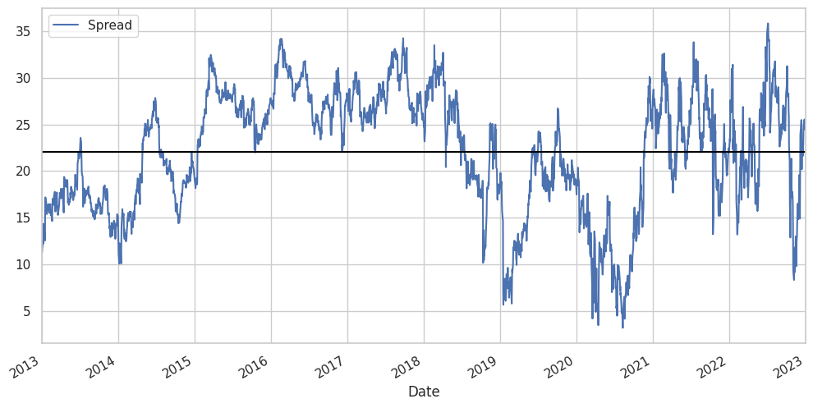
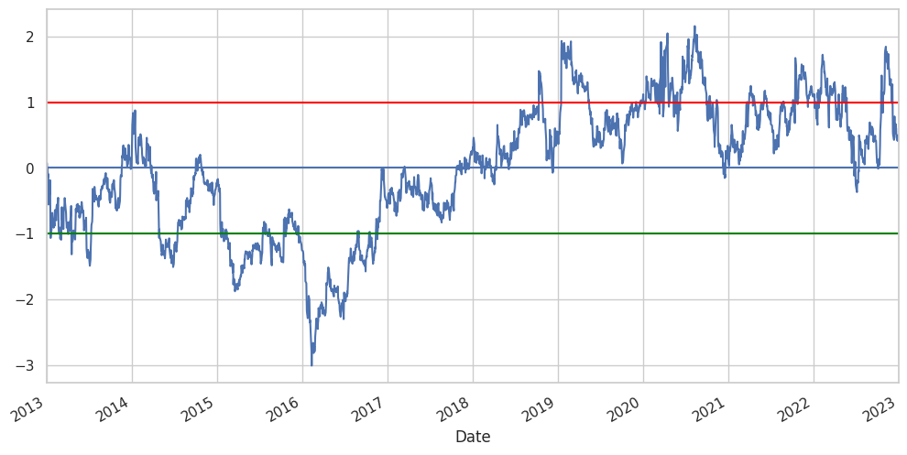
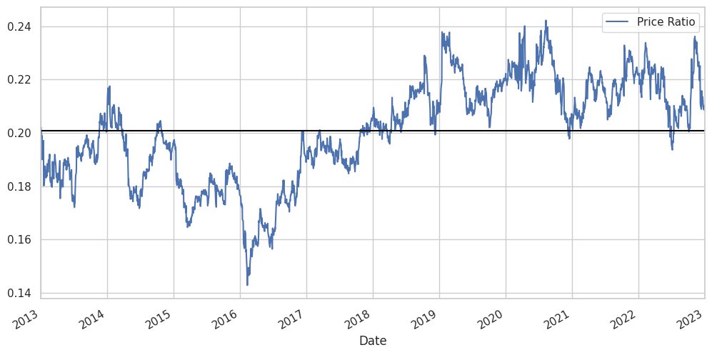
Historical Context
Historical Performance
Graphs for the adjusted spread, price ratio, and z-score of the price ratio over the same period

Slide 6
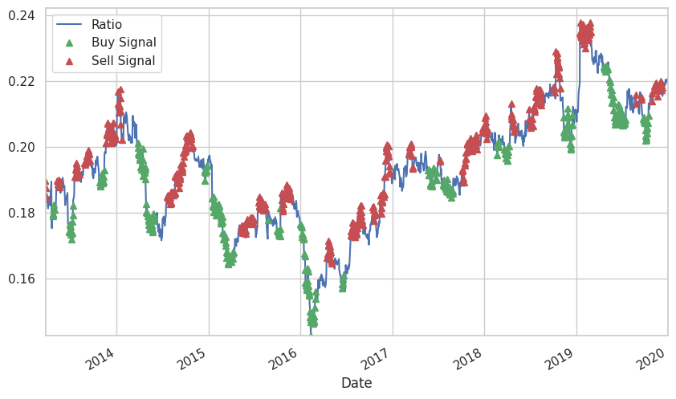
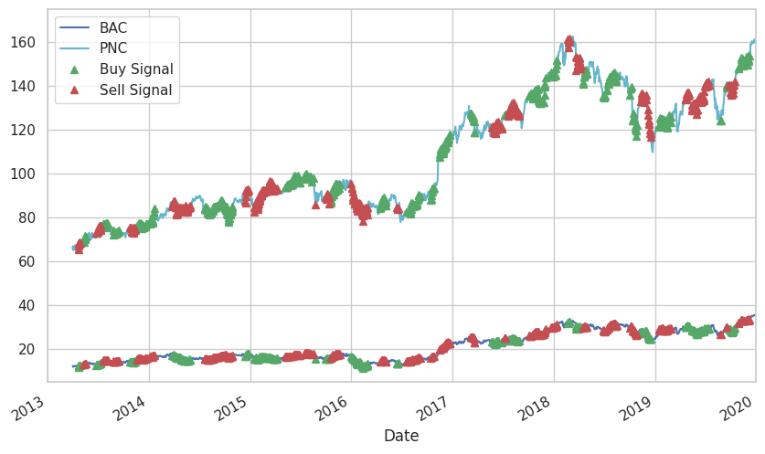
Trading Implementation Z-score using comparative window means and 60-day SD
Trading Scheme
Comparing an X-day moving average of the ratio of prices versus a Y-day moving average of the ratio of prices
Buying the ratio means buying BAC and selling PNC and selling the ration means selling BAC and buying PNC
Determination for X and Y was performed using an optimization function
Graphs show the buy and sell signals relative to the ratio in the top figure and the stock prices in the bottom figure (for the training set)
Notes:
Jack

Slide 7
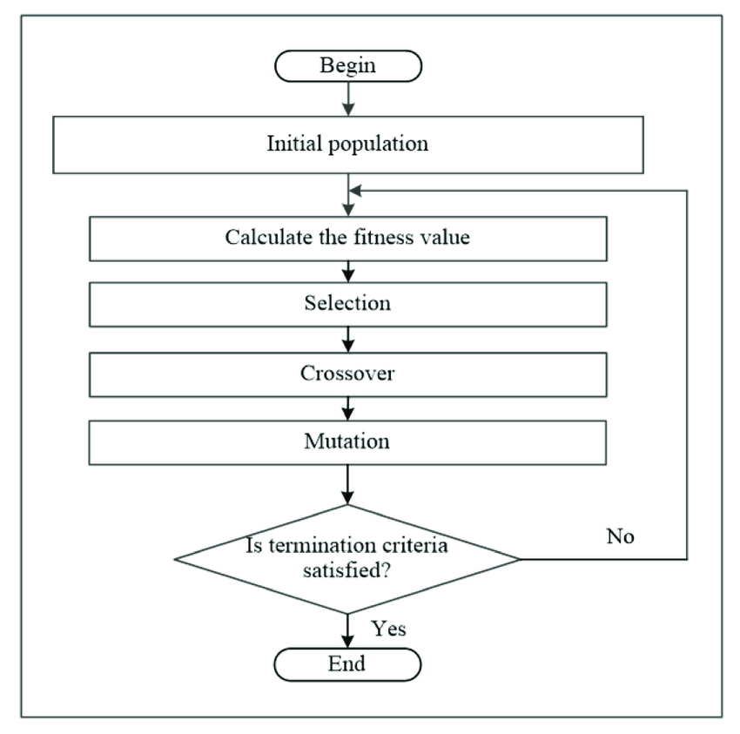
Optimization Function Genetic Algorithm for Optimization
Genetic Algorithm
PyGAD: Python genetic algorithm package
Trained on pre-2020 data
Emulates "natural selection": optimization algorithm improves fitness (Sharpe ratio) over generations
Parameters
Moving average windows
Buy/sell Z-score
Close position Z-score
Results:
Windows: 36-day vs. 199-day
Buy/sell when |z-score| > 0.75
Close position when |z-score| < 0.15
Notes:
Jack

Slide 8
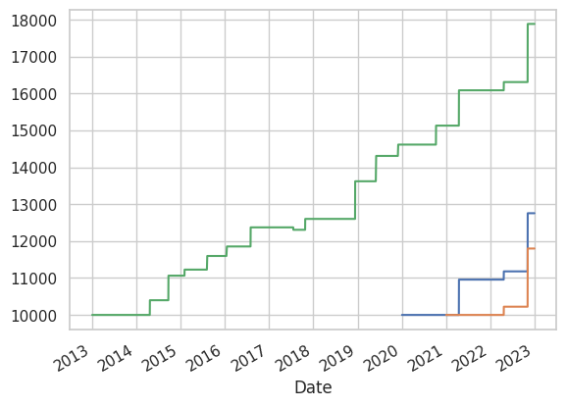
Returns
Various Return Statistics
2020-2023 (incl. COVID-19)
initial holdings: 10000
end portfolio value: 12756.89
total return: 2756.89
Sharpe: 2.0233994566596154
2021-2023 (not incl. COVID-19)
initial holdings: 10000
end portfolio value: 11799.68
total return: 1799.68
Sharpe: 0.9762018305226658
2013-2023 (whole window)
initial holdings: 10000
end portfolio value: 17888.36
total return: 7888.36
Sharpe: 3.095029152437002

Slide 9
Future Considerations
Dependence on Volatility
Better Optimization
Improving Data Splits
The algorithm tends to benefit more when stocks are more volatile and create further opportunity to capitalize on divergence from each other
Choosing banks means that prices are highly correlated with the rest of the market
With similar assets in the same market, there is even less opportunity for prices to diverge
PyGAD allows for the integration of Keras and PyTorch which could help further optimize the trading algorithm
Better signals than just price could be utilized as the genetic algorithm can take numerous inputs to maximize a certain output (Sharpe/Returns)
Implementing machine learning could help tackle concept drift problem common in trading algorithms
Because the algorithm uses sliding windows, a further step could be taken by randomizing the training windows and testing windows
Could help the algorithm better adapt to specific high volatility scenarios (e.g., COVID-19)
Similarly, could utilize an LSTM or GRU to account for memory depending on randomization of testing windows

Slide 10
Contributions & Citations
Matthew – Code, Signal selection, Presentation, Trading algorithm, Backtesting, Asset selection
Jack – Code, Presentation, PyGAD optimization
Abhishek – Presentation, Initial Planning
Daniel – Planning, Communication with board member
https://arxiv.org/pdf/2211.07080.pdf
https://link.springer.com/article/10.1007/s00186-021-00751-z
https://wire.insiderfinance.io/pair-trading-mean-reversion-strategy-using-quant-and-data-science-d864445a2d56
https://pygad.readthedocs.io/en/latest/

